Slide 1
Lecture 5d Analyzing Non-Recursive Algorithms

Slide 2
Summary
Rules re types of program statements
Typical plan for analysis of non-recursive programs
Examples
Analysis of recursive programs – later in topic Recurrence Relations

Slide 3
Sometimes we are looking for the exact formula for the number of operations, sometimes for the efficiency class only

Slide 4
General Rules regarding program statements

Slide 5
Consecutive Statements
Consecutive statements
A; B
t = t_{A} + t_{B}
Assume t_{A}(n)=Θ(f(n)) & t_{B}(n)=Θ(g(n))
By the rule for sums
t = Θ(f(n)+g(n))
By the maximum rule
t = O(max(O(t_{A})+O(t_{B})))

Slide 6
If Statements
If statements
if c then A else B
Better if we can evaluate the condition c
see example later
If we can’t
t = O(max(t_{A},t_{B}))

Slide 7
For Statements
For statements
Typically n times the body, or using Σ
However may be different: example
for i=1 to n do
if even(i) then s = s*p
multiplication will be executed n/2 times only

Slide 8
While Statements
While statements
Sometimes same as for statements
Sometimes recurrence relations
Sometimes something else or difficult

Slide 9
Typical Plan for Analysis of Iterative Algorithms
Decide on parameter n indicating input size
Identify algorithm’s basic operation
Typically in the innermost loop
Determine what are the worst, average, and best cases
For each of them (or only for the worst case) set up a sum for the number of times the basic operation is executed
Sometimes recurrence relation - later
Simplify the sum using standard formulas and rules

Slide 10
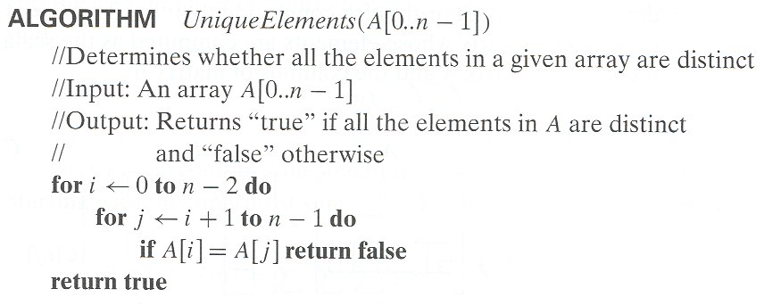
Example 1: Element uniqueness problem

Slide 11
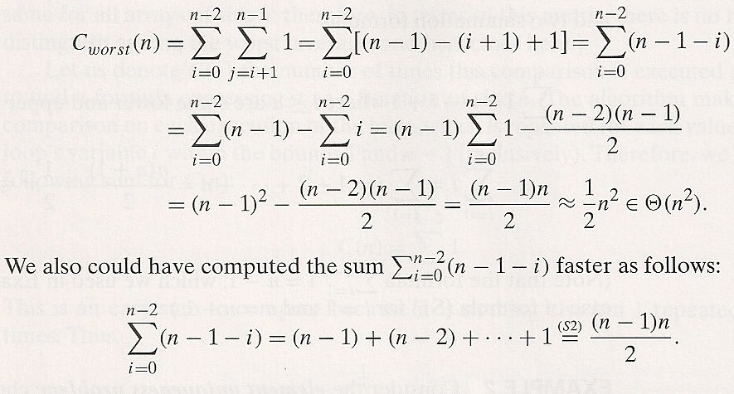

Example 1: Element uniqueness problem
c - comparisons
Precise formula
Order

Slide 12
Example 1: Element uniqueness problem
c_{best}(n) = 1

Slide 13
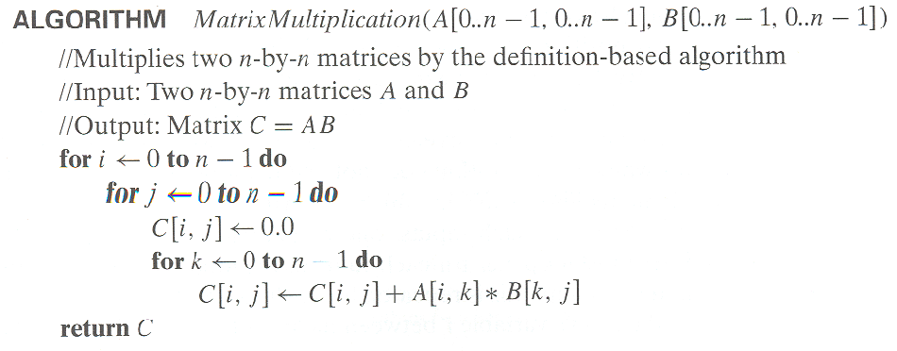
Example 2: Matrix multiplication

Slide 14
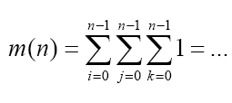
Example 2: Matrix multiplication
m - multiplications

Slide 15
Example 2: Matrix multiplication
≈n times
≈n times
≈n times
1
Θ(n³)
Simplified analysis – finding the order only

Slide 16


Simplified Analysis

Slide 17
Example 3: Gaussian elimination
Algorithm GaussianElimination(A[0..n-1,0..n])
//Implements Gaussian elimination of an n-by-(n+1) matrix A
for i ← 0 to n - 2 do for j ← i + 1 to n - 1 do for k ← i to n do
A[j,k] ← A[j,k] - A[i,k] ∗ A[j,i] / A[i,i]

Slide 18
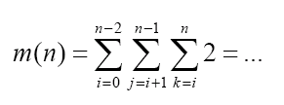
Example 3: Gaussian elimination
Algorithm GaussianElimination(A[0..n-1,0..n])
//Implements Gaussian elimination of an n-by-(n+1) matrix A
for i ← 0 to n - 2 do for j ← i + 1 to n - 1 do for k ← i to n do
A[j,k] ← A[j,k] - A[i,k] ∗ A[j,i] / A[i,i]
m – multiplications and divisions

Slide 19
2

Slide 20
Example 3: Gaussian elimination
Algorithm GaussianElimination(A[0..n-1,0..n])
//Implements Gaussian elimination of an n-by-(n+1) matrix A
for i ← 0 to n - 2 do for j ← i + 1 to n - 1 do for k ← i to n do
A[j,k] ← A[j,k] - A[i,k] ∗ A[j,i] / A[i,i]
≈n times
≈n times
≈n times
O(1)
O(n³)
Simplified analysis still OK for O, usually for Θ as well

Slide 21
Recall: Typical Plan for Analysis of Iterative Algorithms
Decide on parameter n indicating input size
Identify algorithm’s basic operation
Typically in the innermost loop
Determine what are the worst, average, and best cases
For each of them (or only for the worst case) set up a sum for the number of times the basic operation is executed
Sometimes recurrence relation - later
Simplify the sum using standard formulas and rules

Slide 22
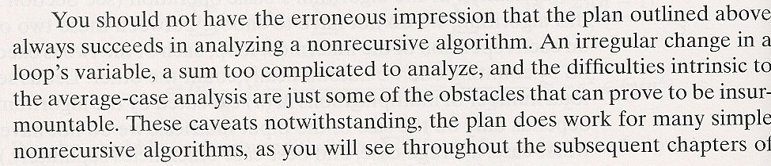
Typical Plan for Analysis of Iterative Algorithms

Slide 23
Russian multiplication
result = 0
halves = x
doubles = y
while (halves > 0)
if halves mod 2 = 1
then result = result + doubles
halves = halves div 2
doubles = doubles * 2
It cannot be investigated in the way the previous examples were (no loop parameter).

Slide 24
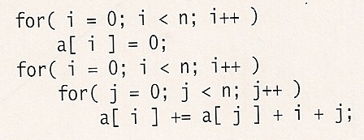
Example 4
O(n)
O(n²)
Consecutive statements
t(n) = O(n) + O(n²) = O(n²)

Slide 25
Recall: Consecutive Statements
Consecutive statements
A; B
t = t_{A} + t_{B}
Assume t_{A}(n)=Θ(f(n)) & t_{B}(n)=Θ(g(n))
By the rule for sums
t = Θ(f(n)+g(n))
By the maximum rule
t = O(max(O(t_{A})+O(t_{B})))

Slide 26
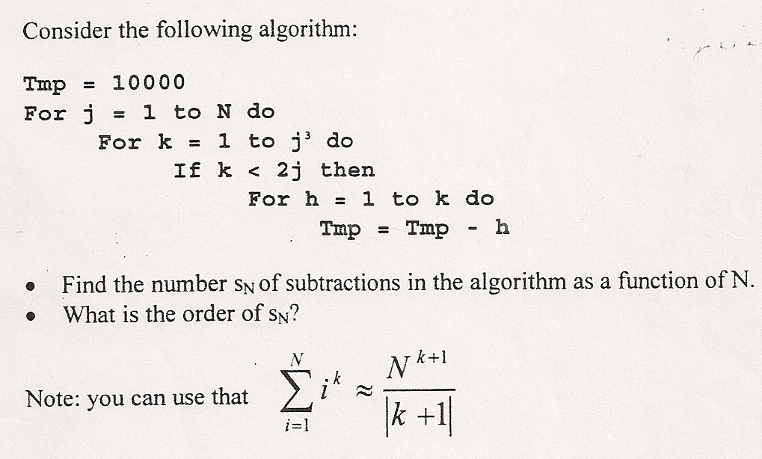
Example 5

Slide 27
Example 5
≈N times
≈N³ times
N³ times
1
O(N⁷)

Slide 28
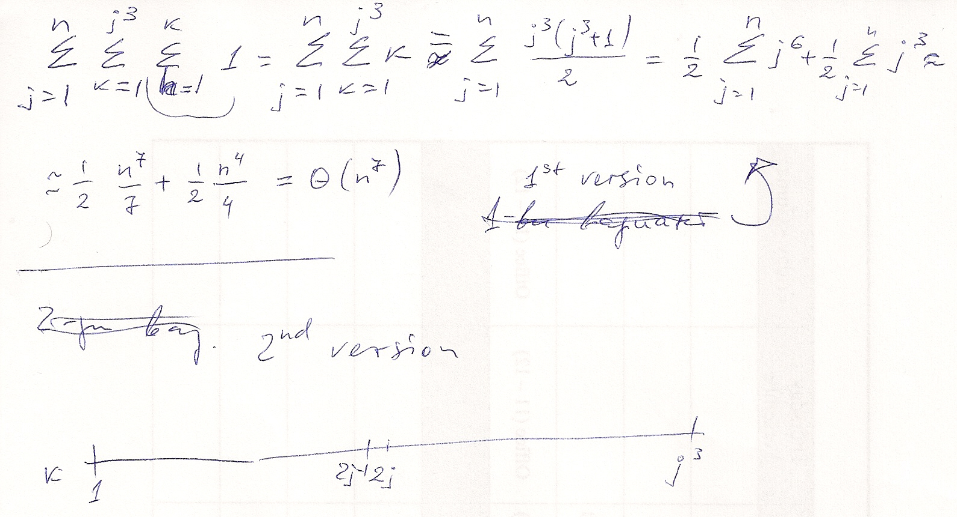
Example 5
O

Slide 29
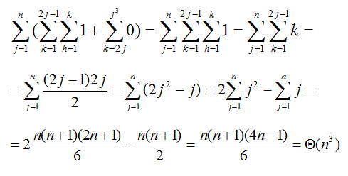
Example 5 – second solution

Slide 30
Some more examples

Slide 32

Example cont’ed
Original algorithm is O(n)
The algorithm computes
S =
S = n*(n+1)*(n+n+1)/6
Improved algorithm is O(1)

Slide 35
For 2 consecutive elements, 3 comparisons here instead of 4 as in the original algorithm

Slide 36
Summary
Analysis of non-recursive programs
Typical plan
Rules re types of program statements
Consecutive statements
Conditional statements
Iterative statements
Simplified analysis
Detailed analysis using summations
Examples
Analysis of recursive programs – later in topic Recurrence Relations

